Slide 1
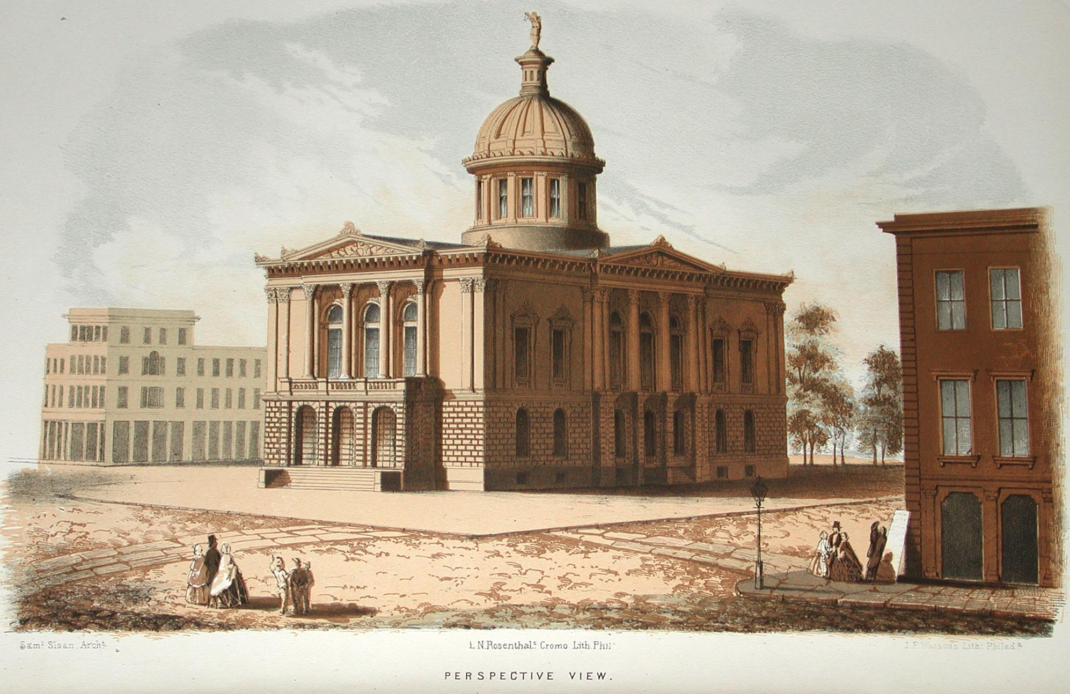
Architecture

Slide 2
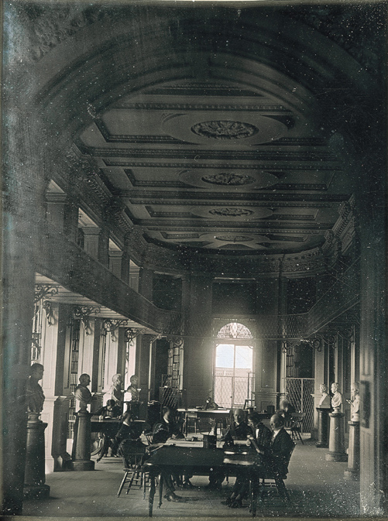
The Boston
Athenaeum

Slide 3

oldest independent libraries in the United States
one of the only sixteen extant membership, libraries, meaning that patrons pay a yearly subscription fee to use the Athenaeum’s services
“Athenaeum”: An association of persons interested in scientific and literary pursuits, meeting for the purpose of mutual improvement; a literary or scientific club or a building or institution in which books, periodicals, and newspapers are provided for use; a literary club-room, reading-room, library
a place for Athena, the goddess of wisdom who inspires intellectual pursuits
expanded to include a library encompassing books in all subjects in English and foreign languages, a gallery of sculptures and paintings, collections of coins and natural curiosities, and even a laboratory
finest library in the country in the early 18th century
one of Boston’s leading cultural institutions

Slide 4
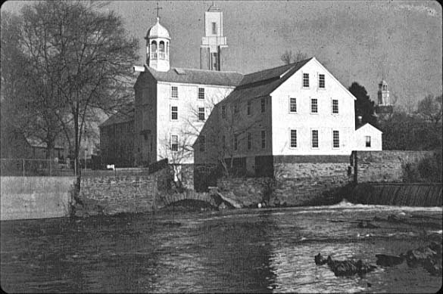
Slater’s Mill

Slide 5
oldest still-standing cotton mill in America
modeled after the mills in England
served as one of the first commercially viable water-powered roller cotton-spinning mill
was used to convert raw cotton into cloth
depended on the waterpower of Pawtucket Falls for its energy
New England was rich in swiftly flowing streams that could provide power to spinning machines and power looms

Slide 6
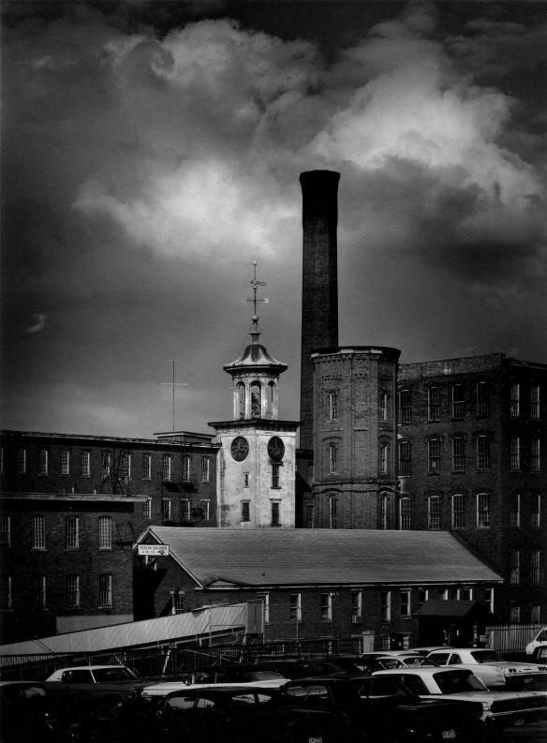
The Lowell
Mills

Slide 7
Francis Cabot Lowell invented the first factory system “where all the factory steps are under one roof”
combined the textile processes of spinning and weaving under one roof, essentially eliminating the putting-out system in favor of mass production of high-quality cloth
workforce at these factories was three-quarters women
impacted by economic instability and by immigration
mills are located on the Merrimack River, while nearby are the boarding houses for single women

Slide 8
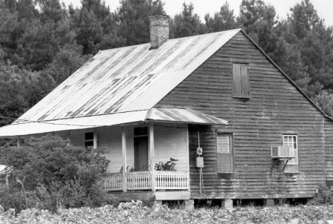
Creole Cottage

Slide 9
scattered throughout the city of New Orleans
most being built between 1790-1850
majority of these cottages are found in the French Quarter
one-story, set at ground level
have a steeply pitched roof, with a symmetrical four-opening façade wall, with a wood or stucco exterior
usually set close to the property line

Slide 10
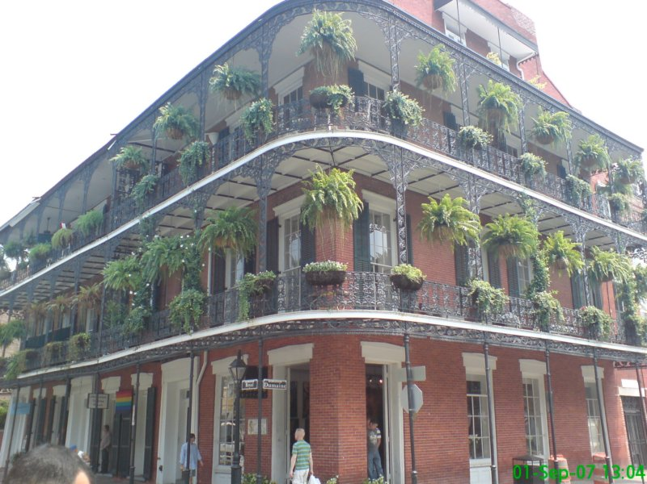
French Quarter

Slide 11
due to refurbishing in the Victorian Style after the Louisiana purchase, only a handful buildings in the French Quarter preserve their original Colonial Spanish or French architectural styles
two-thirds of the French Quarter structures date back from the first half of the 19th century, the most prolific decade being the 1820s
records show that not a single Spanish architect was operating in the city: only French and American were, the latter gradually replacing the former as Creole style was being replaced by Greek revival architecture in the 1830s and 1840s

Slide 12
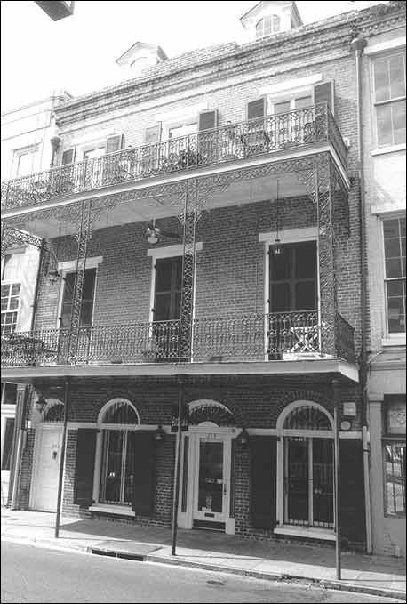
American
Townhouse

Slide 13
were built in 1820-1850
are narrow, three-story structures made of stucco or brick
an asymmetrical arrangement of the façade with a balcony on the second floor sits close to the property line

Slide 14
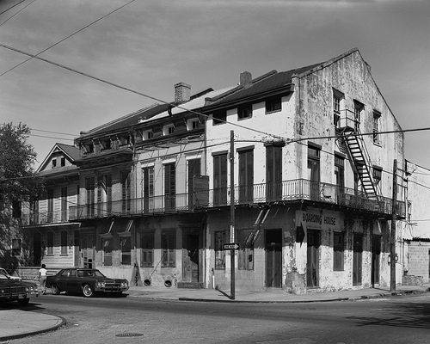
Creole Townhouse

Slide 15
the most iconic pieces of architecture in the city of New Orleans
comprising a large portion of the French Quarter and the neighboring Faubourg Marigny
built after the Great New Orleans Fire (1788) until the mid-10th century
an asymmetrical arrangement of arched openings
have a steeply pitched roof, side-gabled, with several roof dormers
The exterior is made of brick or stucco
almost the same as the Creole Cottage

Slide 16
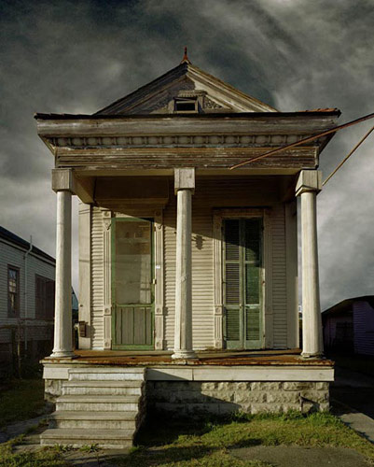
Shotgun
House

Slide 17
a narrow rectangular domestic residence
usually no more than 12 feet (3.5 m) wide, with doors at each end
this style of architecture developed in New Orleans
is the city's predominant house type were built from 1850
one-story, narrow rectangular house raised on brick piers
most have a narrow porch covered by a roof apron that is supported by columns and brackets, which are often ornamented with lacey Victorian motifs

Slide 18
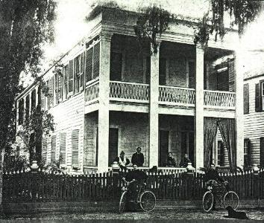
Double-gallery House

Slide 19
were built in New Orleans between 1820-1850
are two-story houses with a side-gabled or hipped roof
set back from the property line
has a covered two-story galleries which are framed and supported by columns supporting entablature
façade has an asymmetrical arrangement of its openings
built as a variation of the American Townhouses

Slide 20
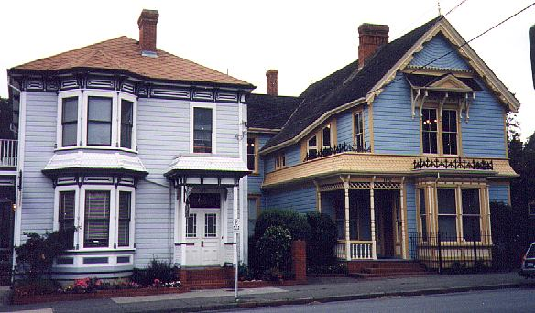
Preindustrial City

Slide 21
rich and poor lived side by side
neat row houses in a dense, small scale housing pattern
fostered neighborliness
merchants lived next to their business

Slide 22
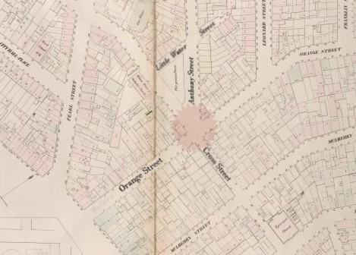
The Five Points

Slide 23
located in lower Manhattan
segregated housing patterns
a notorious slum centered on the five-cornered intersection
most middle and upper class inhabitants fled, leaving the neighborhood completely open to the influx of poor immigrants
was the first large-scale instance of volitional racial integration in American history
was situated close enough for a walking commute to the large mercantile employers of the day in and around the dockyards at the island’s southern tip
to have sustained the highest murder rate of any slum in the world

Slide 24
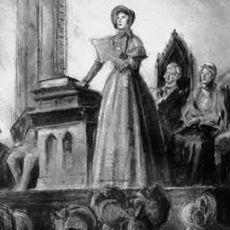
Seneca
Falls

Slide 25
an early and influential women's rights convention
was organized by local New York women
local women, primarily members of a radical Quaker group
Elizabeth Cady Stanton, a skeptical non-Quaker who followed logic more than religion
The meeting spanned two days and six sessions, and included a lecture on law, a humorous presentation, and multiple discussions about the role of women in society
a single step in the continuing effort by women to gain for themselves a greater proportion of social, civil and moral rights
viewed by others as a revolutionary beginning to the struggle by women for complete equality with men
the moment when the push for women's suffrage first gained national prominence
indicators of widespread female activists

Slide 26
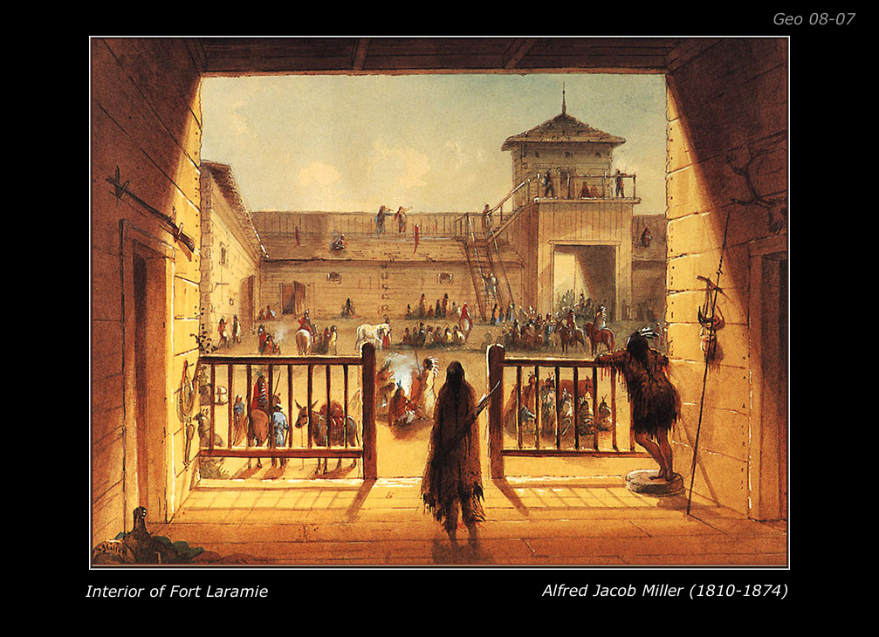
Fort Laramie

Slide 27
a significant 19th century trading post and diplomatic site
Founded in the 1830s to service the overland fur trade
In 1849 it was purchased and its operations were taken over by the United States Army to protect the many wagon trains of migrant travelers on the Oregon Trail

Slide 28
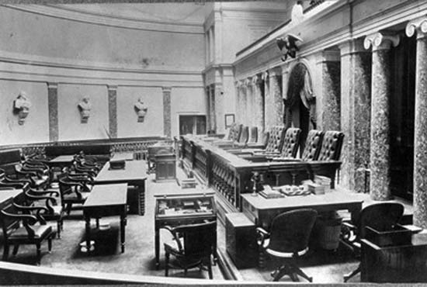
Old Senate Chamber

Slide 29
Located north of the Capitol Rotunda
Home first to the U.S. Senate and later to the U.S. Supreme Court
three major regions attempted to resolve the political crisis was in this court
Henry Clay, John C. Calhoun, and Daniel Webster made the Compromise of 1850

Slide 30
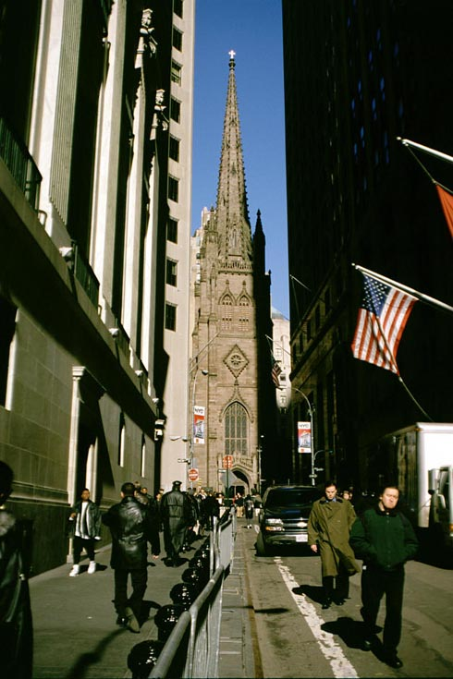
Trinity
Church

Slide 31
also known as Trinity Wall Street
The third Trinity Church was finished in 1846
expanding parish was divided due to the burgeoning cityscape and to better serve the needs of its parishioners
a classic example of Gothic Revival architecture
was a welcoming beacon for ships sailing into the New York Harbor

Slide 32
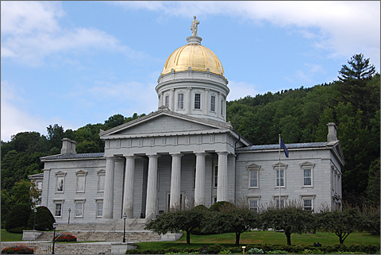
Vermont State House

Slide 33
located in Montpelier, Vermont
the capitol and seat of Vermont General Assembly
has been carefully restored beginning in the early 1980s
originally the dome and roofs were painted a dark terracotta red to suggest Tuscan tile
the dome being located almost directly above the ceilings of Representatives Hall on the second floor
principal space for civic reflection is the Hall of Inscriptions
a Doric plastered corridor featuring eight monumental marble tables incised with quotations about the distinct nature of Vermont’s culture and heritage
each tablet features fourteen gilded stars, representing Vermont’s fourteen countries

Slide 34
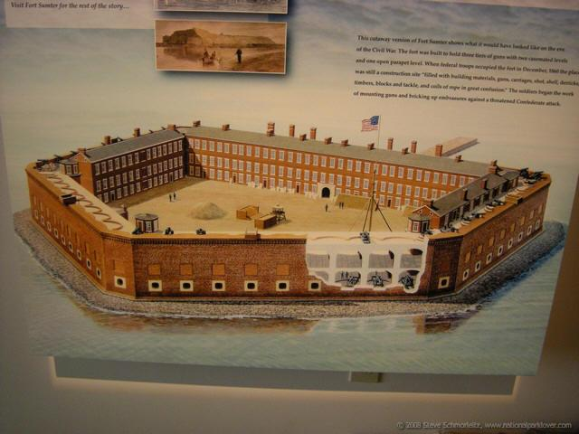
Fort Sumter

Slide 35
Third System masonry coastal fortification
located in Charleston harbor, South Carolina
best known as the site upon which the shots initiating the American Civil War were fired
“Battle of Fort Sumter”
was built following the War of 1812
five-sided brick structure
named after General Thomas Sumter, Revolutionary War hero

Slide 36
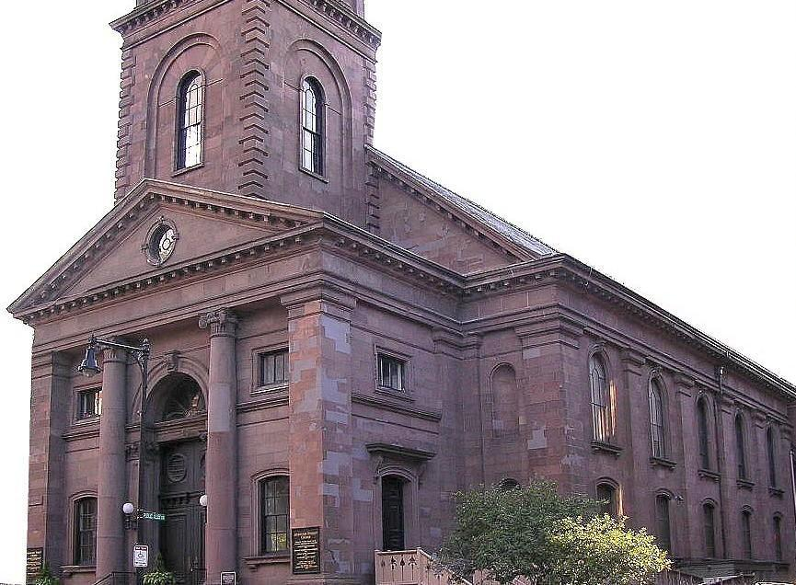
Arlington Street Church

Slide 37
Unitarian Universalist church
located in Boston, Massachusetts
“Church of the Presbyterian Strangers”
the site of the first state-sanctioned same-sex marriage in the United States
interior with Corinthian columns and graceful rounded arches
panels containing the Ten Commandments and the Lord's Prayer
box pews were made of chestnut with black walnut rails
original windows contained clear glass

Slide 38
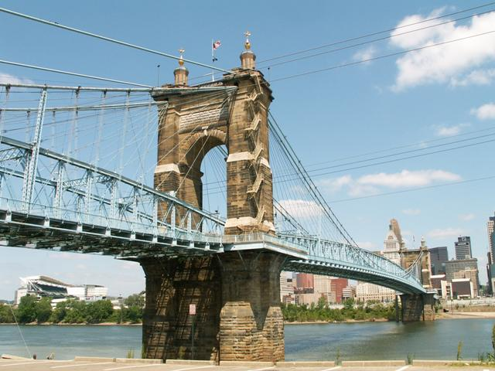
John A. Roebling Suspension Bridge

Slide 39
spans the Ohio River between Cincinnati, Ohio and Covington, Kentucky
in 1866, it was the longest suspension bridge in the world
ramps were constructed leading directly from the bridge to the Dixie Terminal building used for street cars
a foundation was set consisting of 13 layers of oak beams
sandstone was used for the first twenty five vertical feet of each tower base
work on the bridge proceeded steadily after the end of the Civil War

Slide 40
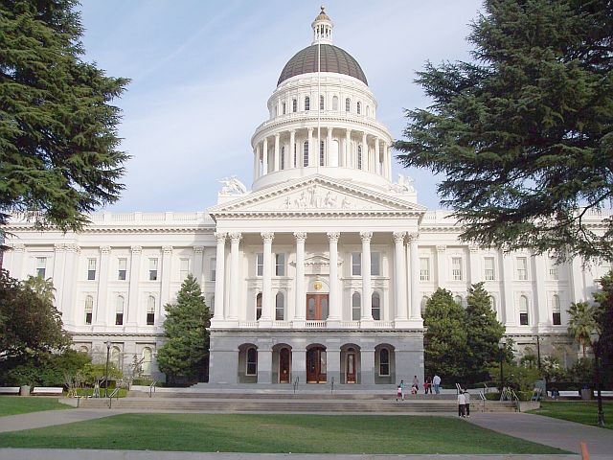
California State Capitol

Slide 41
the seat of the government of California
housing the chambers of the state legislature and the office of the governor in Sacramento
the Neoclassical structure was completed between 1861 and 1874 at the west end of Capitol Park
at the base of the portico, seven granite archways brace and support the porch above
a cornice supports the pediment above depicting Minerva surrounded by Education, Justice, and Mining
the drums at the top of the roof consists of a colonnade of Corinthian columns and Corinthian pilasters

Slide 42
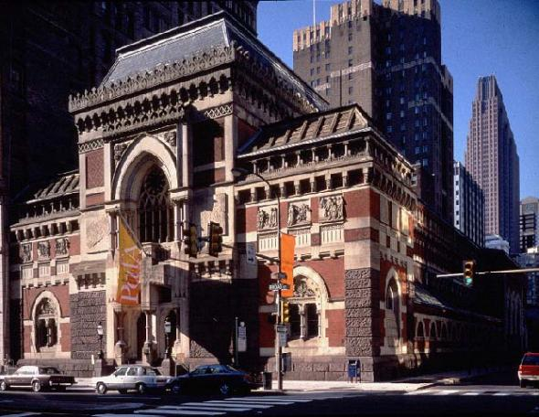
Pennsylvania Academy of Fine Arts

Slide 43
is a museum and art school in Philadelphia, Pennsylvania
it was founded in 1805
the oldest art museum and school in the United States
the Academy's museum is internationally known for its collections of 19th and 20th century American paintings, sculptures, and works on paper
its archives house important materials for the study of American art history, museums, and art training
founded by scientist Charles Willson Peale, sculptor William Rush, and other artists and business leaders
held its exhibitions for many years in a modern building of the ionic order designed by John Dorsey
opened as a museum with more than 500 paintings and statuary that were on display

Slide 44

Terms and People

Slide 45
TERMS
box pews: a type of church pew that is encased in paneling and was prevalent in England and other Protestant countries from the 16th to early 19th century.
Neoclassical: "new" classical, architecture describes buildings that are inspired by the classical architecture of ancient Greece and Rome.
Portico: a porch leading to the entrance of a building, or extended as a colonnade, with a roof structure over a walkway, supported by columns or enclosed by walls. This idea first appeared in Ancient Greece and has influenced many cultures, including most Western cultures.
Cornice: generally any horizontal decorative molding that crowns any building or furniture element: the cornice over a door or window, for instance, or the cornice around the edge of a pedestal.
Ionic order: forms one of the three orders or organizational systems of classical architecture, the other two canonic orders being the Doric and the Corinthian.
PEOPLE
General Thomas Sumter: born in Virginia, August 14, 1734 the son of William and Patience Sumter. Educated in common schools he engaged in surveying in Virginia, worked in his father's mill and after his father's early death cared for his mother's sheep and plowed his neighbor's fields.
Charles Willson Peale: well-known American portraitist, was born in Queen Anne's County, Maryland in 1741. He arrived in Annapolis at the age of nine as an apprentice to a local saddler.

Slide 46
TERMS
preindustrial: Of, relating to, or being a society or an economic system that is not or has not yet become industrialized.
Slum: A heavily populated urban area characterized by substandard housing and squalor
volitional: Belonging or relating to the act or an instance of making a conscious choice or decision.
Prominence: The quality or condition of being projecting outward or upward from a line or surface
bourgeon: To put forth new buds, leaves, or greenery; sprout
PEOPLE
Elizabeth Cady Stanton: an American social activist, abolitionist, and leading figure of the early woman's movement.
Lucretia Mott: an American Quaker, abolitionist, social reformer, and proponent of women's rights. She is credited as the first American “feminist” in the early 19th century but was, more accurately, the initiator of women's political rights.

Slide 47
TERMS
patrons: the support, encouragement, privilege, or financial aid that an organization or individual bestows to another.
Athenaeum: an association of persons interested in scientific and literary pursuits, meeting for the purpose of mutual improvement; a literary or scientific club or a building or institution in which books, periodicals, and newspapers are provided for use; a literary club-room, reading-room, library
loom: a device used to weave cloth
stucco: render is a material made of an aggregate, a binder, and water
motifs: a smaller element in a much larger work
PEOPLE
Francis Cabot Lowell: U.S. businessman. Born into a prominent Massachusetts family, Lowell closely studied the British textile industry while visiting Britain.
Athena: the Greek goddess of wisdom, war, the arts, industry, justice and skill. She was the favorite child of Zeus. She had sprung fully grown out of her father's head.

Slide 48

QUESTIONS

Slide 49

The oldest independent library in the United States and a place for the goddess of wisdom, Athena, is called what?

Slide 50
ANSWER: The Boston Athenaeum

Slide 51
What is the oldest still-standing cotton mill in America called?

Slide 52
ANSWER: Slater’s Mill

Slide 53
This place had a workforce in which at least three-quarters of the workers were women. Name the Mill.

Slide 54
ANSWER: The Lowell Mills

Slide 55
Name the cottage in which the majority of them are found in the French Quarter throughout the city of New Orleans.

Slide 56
ANSWER: Creole Cottage

Slide 57
Fill in the blank: Two-thirds of the ____ ___ structures date back from the first half of the 19th century.

Slide 58
ANSWER: French Quarter

Slide 59
Name the house described as narrow, three-story structure made of stucco or brick.

Slide 60
ANSWER: American Townhouse

Slide 61
Name the townhouse that was built after the Great New Orleans Fire in 1788.

Slide 62
ANSWER: Creole Townhouse

Slide 63
Name the house described as a narrow rectangular domestic residence, usually no more than 12 feet wide, with doors at each end.

Slide 64
ANSWER: Shotgun House

Slide 65
Name the house that has a covered two-story galleries which are framed and supported by columns supporting entablature.

Slide 66
ANSWER: Double-Gallery House

Slide 67
Name the athenaeum that was expanded to include a library encompassing books in all subjects in English and foreign languages.

Slide 68
ANSWER: The Boston Athenaeum

Slide 69
In the Preindustrial City, the rich and poor lived side by side. True or False?

Slide 70
ANSWER: True

Slide 71
The Five Points was a notorious ___ centered on the five-cornered intersection.

Slide 72
ANSWER: slum

Slide 73
Seneca Falls in 1848 was an early and influence on which gender?

Slide 74
ANSWER: women

Slide 75
A skeptical non-Quaker who followed logic rather than religion was who?

Slide 76
ANSWER: Elizabeth Cady Stanton

Slide 77
A significant 19th century trading post and diplomatic site was what fort?

Slide 78
ANSWER: Fort Laramie

Slide 79
The Compromise of 1850 was made in which building, located north of Capitol Rotunda?

Slide 80
ANSWER: Old Senate Chamber

Slide 81
Name the building that was a welcoming beacon for ships sailing into the New York Harbor.

Slide 82
ANSWER: Trinity Church

Slide 83
The capitol and seat of the Vermont General Assembly was called what?

Slide 84
ANSWER: Vermont State House

Slide 85
The women's suffrage was caused by Elizabeth Cady Stanton, at what place?

Slide 86
ANSWER: Seneca Falls in 1848

Slide 87
In the ________, merchants lived next to their businesses.

Slide 88
ANSWER: Preindustrial City

Slide 89
Name the best known site upon which the shots initiating the American Civil War was fired.

Slide 90
ANSWER: Fort Sumter

Slide 91
What was the name of the Unitarian Universalist Church located in Boston, Massachusetts?

Slide 92
ANSWER: Arlington Street Church

Slide 93
Name the bridge that spans the Ohio River between Cincinnati, Ohio and Covington, Kentucky.

Slide 94
ANSWER: John A. Roebling Suspension Bridge

Slide 95
What building was housing the chambers of the state legislature and the office of the governor in Sacramento, California?

Slide 96
ANSWER: California State Capitol

Slide 97
What academy opened as a museum with more than 500 paintings and statuary on display?

Slide 98
ANSWER: Pennsylvania Academy of the Fine Arts

Slide 99
Fort Sumter was named after General Thomas Sumter, the Civil War hero. True or False.

Slide 100
ANSWER: False. Revolutionary War hero

Slide 101
Arlington Street Church was the site of the first-state-sanctioned same-sex marriage in the United States. True or False.

Slide 102
ANSWER: True

Slide 103
In 1866, the John A. Roebling Suspension Bridge was considered the longest suspension bridge in the world. True or False.

Slide 104
ANSWER: True

Slide 105
The California State Capitol is the seat of the legislatures and officers in California. True or False.

Slide 106
ANSWER: False. The seat of the government

Slide 107
The Pennsylvania Academy of Fine Arts is not internationally known for its collections of the 19th and 20th century artwork. True or False.

Slide 108
ANSWER: False. It is internationally known.

Slide 109

Reference:
“Trinity Church.” Wikipedia. N.p., 25 11 2010. Web. 2
Dec 2010.
<http://en.wikipedia.org/wiki/Trinity_Church_(New_York_City).>
“Vermont Sate House." Wikipedia. N.p., 20 10 2010.
Web. 2 Dec 2010.
<http://en.wikipedia.org/wiki/Vermont_State_House>.

Slide 110
References:
Campanella, Richard, Geographies of New Orleans:
Urban Fabrics before the Storm, Gretna, LA, Pelican Publishing,
2006.
Kingsley, Karen. Buildings of Louisiana, New York:
Society of Architectural Hisotrians, 2003.
Lewis, Pierce. New Orleans: The Making of an Urban
Landscape, 2nd ed., Sante Fe, NM: Center for American Places,
2003.
Wikipedia, The Free Encyclopedia. 11 Nov. 2010.
<http://en.wikipedia.org/wiki/Buildings_and_architecture_of_New_
Orleans>

Slide 111
References:
"Arlington Street Church." Wikimedia Foundations. Wikipedia, 26 Nov 2010.
Web. 5 Jan 2011.
<http://en.wikipedia.org/wiki/Arlington_Street_Church_(Boston)>.
"California State Capitol." Wikimedia Foundations. Wikipedia, 26
Nov 2010. Web. 5 Jan 2011.
<http://en.wikipedia.org/wiki/California_State_Capitol#Construction_a
nd_design>.
"John A. Roebling Suspension Bridge." Wikimedia Foundations.
Wikipedia, 29 Dec 2010. Web. 5 Jan 2011.
<http://en.wikipedia.org/wiki/John_A._Roebling_Suspension_Bridge#Eng
ineering_achievement>.
"Pennsylvania Academy of the Fine Arts." Wikimedia Foundations.
Wikipedia, 27 Dec 2010. Web. 5 Jan 2011.
<http://en.wikipedia.org/wiki/Pennsylvania_Academy_of_the_Fine_Arts
#History>.

Slide 112


By: Jocelyn Hung

